Slide 1
CS 419: Production Rendering Introduction to BRDFs
Eric Shaffer

Slide 2
Bidirectional Radiance Distribution Functions (BRDFs)
Precise description of surface reflectance at a point
dE_{i}(p,ω_{i}) differential amount of irradiance arriving from a solid angle
dL_{o}(p,ω_{o}) reflected radiance in the direction ω_{o}
BRDF specifies relationship between the two quantities

Slide 3
Bidirectional Radiance Distribution Functions (BRDFs)
Function of p and 2 directions

Slide 4
Reflected Radiance
Integrate the irradiance over the whole hemisphere
Yields total reflected radiance in the ω_{o} direction
This gives us the reflection equation

Slide 5
A Perfect Diffuse BRDF
Perfect diffuse reflection is called Lambertion reflection
Reflected radiance is independent of the outgoing direction

Slide 6
Perfect Diffuse BRDF
Perfect diffuse reflectance
Fraction of total incident flux reflected into hemisphere above a surface element

Slide 7
Implementing a Perfect Diffuse BRDF
is an rgb color
is the diffuse reflectance coefficient
is the diffuse color

Slide 8
Illumination and Reflection
Illumination: light that arrives at object surfaces
Direct: Light arrives uninterrupted from a light (local)
Indirect: Light arrives after reflecting off other surfaces (global)

Slide 9
Specular Reflection
Perfect specular reflection
Light is reflected in the single direction r
…the mirror reflection direction
Glossy specular reflection
Scattering clustered around mirror reflection direction

Slide 10
Name the Type of Reflection

Slide 11
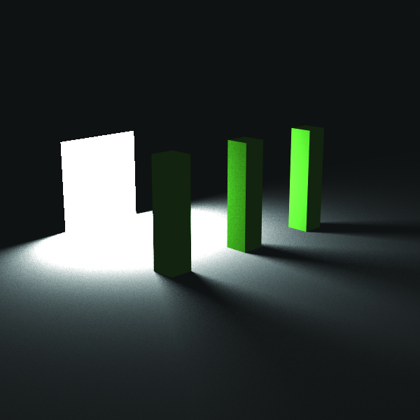
Lights
We will start with non-physical lights
Ambient
Directional
Point
All have:
a color c_{l}
radiance scaling factor l_{s}
What do directional and point have that ambient doesn’t?
What does point have that the other two don’t?

Slide 12

Ambient Light
Models indirect diffuse illumination
Not even close to physically correct
Isotropic 3D radiance field
Incident Radiance Reflected Radiance
“A good candidate for most boring image in the book”

Slide 13
Directional Lights
Light rays are parallel
Approximation to Sun’s rays hitting the Earth
Incident radiance does not vary with position
Reflected radiance:

Slide 14
Point Lights
Have a position
Have no surface area
Allow us to model distance attenuation
What does (b) below show?

Slide 15
Point Lights
Reflected radiance:
r is distance from p to the light
You can choose not to attenuate
Can sometimes cause artifacts like overflow
Fall-off may look unrealistically sharp

Slide 16

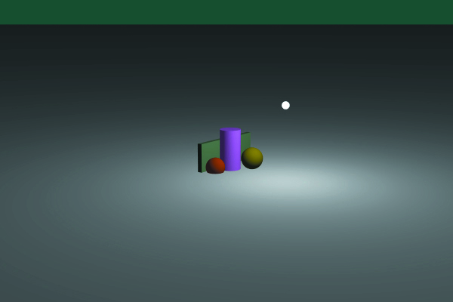
Point Lights
Which is attenuated? Why do both decrease with distance?

Slide 17
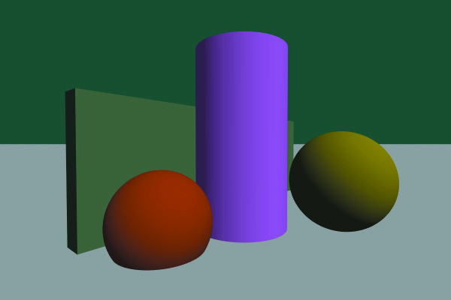
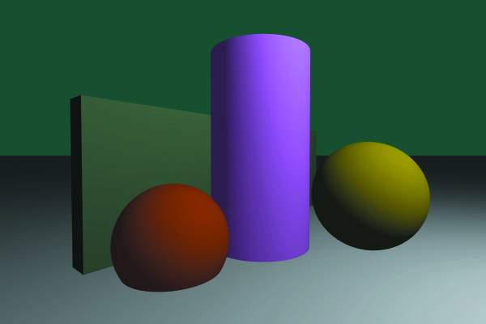
Comparison
Which is point and which is directional?

Slide 18
Diffuse Shading
Multiple lights are handled by summing up the illumination
Note: cosine can be implemented as n•l_{j}

Slide 19
Diffuse Shading
Do we need to check if a point is visible to a light?

Slide 20
Two-Sided Shading
Rendering shell-like surfaces requires two-sided lighting
If a hit point is on the inside of the surface, normal must be flipped
How can you detect this?
Transparent objects must be handled differently

Slide 21
Materials
Ray Tracing from the Ground Up models materials using BRDFs
Each material has multiple BRDFs
Ambient
Lambertian
Specular
Don’t feel constrained to implement everything the same way
We’ll discuss more complicated BRDFs later in the semester

Slide 22
Out-of-Gamut Colors
Color values we can display are in [0,1]³
…but it’s possible for values to exceed 1
these are out of gamut colors
You can render in HDR and apply local tone-mapping
HDR=High Dynamic Range
Or you can clamp
Take largest value exceeding 1 and divide all channels by it
Maintains the hue

Slide 23
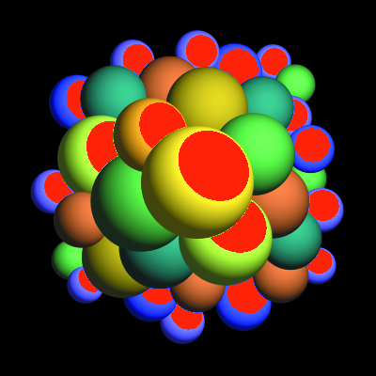
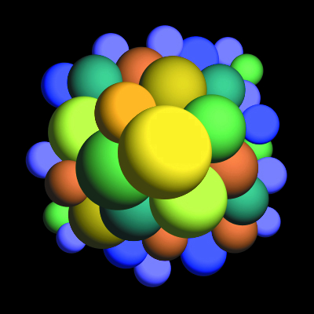
Out-of-Gamut Colors

